Slide 1
K Nearest Neighbor

Slide 2
Example - Dataset
Name | Age | Gender | Sport
Madhu | 32 | M | Football
Sara | 40 | M | Neither
Raj | 16 | F | Cricket
vinoth | 34 | F | Cricket
Laxmi | 55 | M | Neither
Ritu | 40 | M | Cricket
Nakul | 20 | F | Neither
Megha | 15 | M | Cricket
Thejo | 55 | F | Football
Smith | 15 | M | Football

Slide 3
New Data
Name | Age | Gender | Sport
Sachin | 5 | F | ?

Slide 4
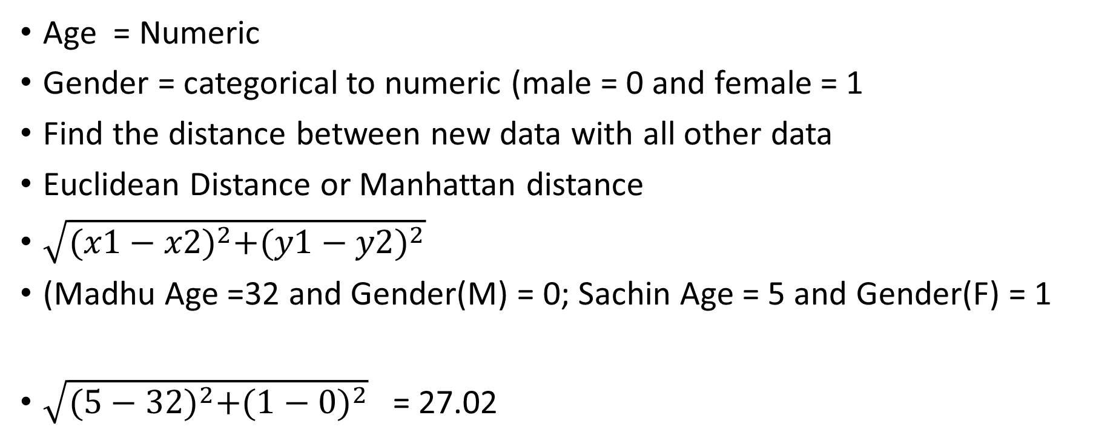
K= 3
Age = Numeric
Gender = categorical to numeric (male = 0 and female = 1
Find the distance between new data with all other data
Euclidean Distance or Manhattan distance
$\sqrt{{(x1−x2)}^{2}+{(y1−y2)}^{2}}$
(Madhu Age =32 and Gender(M) = 0; Sachin Age = 5 and Gender(F) = 1
$\sqrt{{(5−32)}^{2}+{(1−0)}^{2}}$ = 27.02

Slide 5
Prediction of KNN
K = 3
Output :
Sachin Likes Cricket
Name | Age | Gender | Distance | Sport
Madhu | 32 | 0 | 27.02 | Football
Sara | 40 | 0 | 35.01 | Neither
Raj | 16 | 1 | 11.00 | Cricket
vinoth | 34 | 1 | 9.00 | Cricket
Laxmi | 55 | 0 | 50.01 | Neither
Ritu | 40 | 0 | 35.01 | Cricket
Nakul | 20 | 1 | 15.00 | Neither
Megha | 15 | 0 | 10.00 | Cricket
Thejo | 55 | 1 | 50.00 | Football
Smith | 15 | 0 | 10.05 | Football

Slide 6
How to choose K
We will see it in programming.

